Slide 1
Deadlock Handling

Slide 2
What are Deadlocks?
A deadlock is a condition where two or more transactions are waiting indefinitely for one another to give up locks. Deadlock is said to be one of the most feared complications in DBMS as no task ever gets finished and is in waiting state forever.
For example: In the student table, transaction T1 holds a lock on some rows and needs to update some rows in the grade table. Simultaneously, transaction T2 holds locks on some rows in the grade table and needs to update the rows in the Student table held by Transaction T1.
Now, the main problem arises. Now Transaction T1 is waiting for T2 to release its lock and similarly, transaction T2 is waiting for T1 to release its lock. All activities come to a halt state and remain at a standstill. It will remain in a standstill until the DBMS detects the deadlock and aborts one of the transactions.

Slide 3
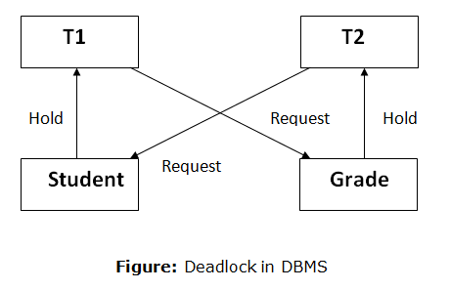

Slide 4
Deadlock Handling
There are three classical approaches for deadlock handling, namely −
Deadlock prevention.
Deadlock avoidance.
Deadlock detection and removal.
All of the three approaches can be incorporated in both a centralized and a distributed database system.

Slide 5
Deadlock Prevention
Deadlock prevention method is suitable for a large database.
If the resources are allocated in such a way that deadlock never occurs, then the deadlock can be prevented.
The Database management system analyzes the operations of the transaction whether they can create a deadlock situation or not.
If they do, then the DBMS never allowed that transaction to be executed.

Slide 6
Deadlock Avoidance
When a database is stuck in a deadlock state, then it is better to avoid the database rather than aborting or restating the database. This is a waste of time and resource.
Deadlock avoidance mechanism is used to detect any deadlock situation in advance. A method like "wait for graph" is used for detecting the deadlock situation but this method is suitable only for the smaller database. For the larger database, deadlock prevention method can be used.

Slide 7
There are two algorithms for this purpose, namely wait-die and wound-wait.
Let us assume that there are two transactions, T1 and T2, where T1 tries to lock a data item which is already locked by T2. The algorithms are as follows −
Wait-Die − If T1 is older than T2, T1 is allowed to wait. Otherwise, if T1 is younger than T2, T1 is aborted and later restarted.
Wound-Wait − If T1 is older than T2, T2 is aborted and later restarted. Otherwise, if T1 is younger than T2, T1 is allowed to wait.

Slide 8
Deadlock Detection and Removal
In a database, when a transaction waits indefinitely to obtain a lock, then the DBMS should detect whether the transaction is involved in a deadlock or not.
The lock manager maintains a Wait for the graph to detect the deadlock cycle in the database.
Wait for Graph
This is the suitable method for deadlock detection. In this method, a graph is created based on the transaction and their lock. If the created graph has a cycle or closed loop, then there is a deadlock.
The wait for the graph is maintained by the system for every transaction which is waiting for some data held by the others. The system keeps checking the graph if there is any cycle in the graph.
The wait for a graph for the above scenario is shown below:

Slide 9
